Slide 1
Software Testing
Code-Based, Unit, Path Testing
(Or, Structure-Based, Unit, Control Flow Testing)
Presented By
Ning Chen, Ph.D.
Professor
Department of Computer
Science
California State University,
Fullerton
© Ning Chen, 2017
*

Slide 2
Module Objectives
This module focuses on the Code-Based, Unit, Path Testing
(Or, Structure-Based, Unit, Control Flow Testing).

Slide 3
Basis Path Testing
Forward learning strategy on this subject is a bit hard (hard to explain the motivation).
Maybe we can try the reversed learning strategy by observing a case.

Slide 4
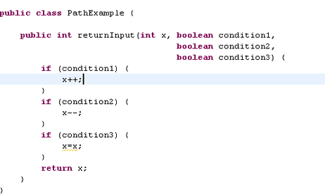
A Piece of Code (under test)

Slide 5
Requirement of this piece of code
Its output should equal its input.

Slide 6
Test Case 1
A test case of (T, T, T) traverses through all statement and it passes.
With this test case, can we claim that we have achieved 100% statement coverage?
  Yes.

Slide 7
Branch Coverage
Has the test case 1 achieved 100% branch coverage?
  No.

Slide 8
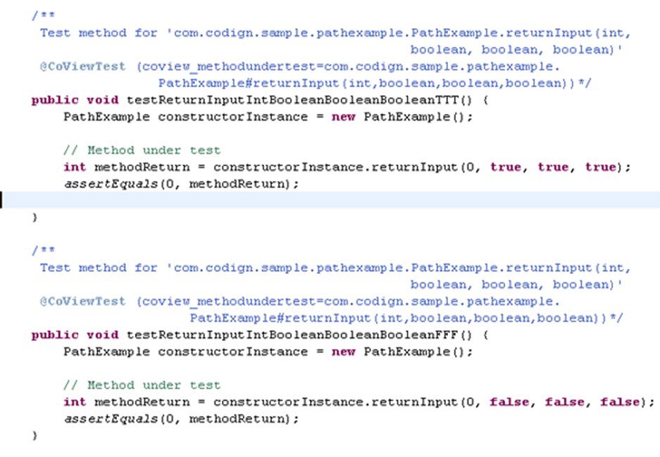
Two Test Cases

Slide 9
Coverage (Statement and Branch)
With 2 test cases, what is our statement coverage?
  100%
What is our branch coverage?
  100%

Slide 10
Do two test cases pass?
Yes.
  Test case 1 (T, T, T) returns x = x
  Test case 2 (F, F, F) does not change x, thus the same x returns.

Slide 11
Level of Confidence
What is our level of confidence?
Have we achieved 100% statement coverage?
  Yes. Test case 1 achieved 100% statement coverage.
Have we achieved 100% branch coverage?
  Yes. Two test cases together achieved 100% branch coverage.
Do our two test cases fail?
  No. They both passed (with flying color…)
Can we say our program now is bug free?
  Obviously, no. There is no such thing as bug free program.
Can we, at least, say that our level of confidence on the quality of our software is HIGH?
  Well, ….

Slide 12
Do We Have a Bug?
Yes. We do.
  If you are careful, you may notice that a test case of (T, F,T) or (F,T,T) will fail and reveal the bug.

Slide 13
100% Statement and Branch Coverage are no good!
What we want (at lest trying) is 100% path coverage.
What do you mean Path?

Slide 14
Path
A path is a unique traversal from Entry to Exit.

Slide 15
How may paths?
For our piece of code, how many paths do we have?
Ans: 2 x 2 x 2 = 8 (three 2-way decision statements).

Slide 16
How to catch the bug?
If you achieve 100% path coverage, yes, you can catch the bug.
Test cases:
  (T,T,T), (T,T,F), (T, F, T), (T,F,F), (F,T,T)
  (F,T,F), (F,F,T), (F,F,F)
As pointed out before, at least one test case (T,T,F) catches a bug.

Slide 17
Do we really need 100% path coverage?
If we do, a 10-decision program, will need us to come up with 2¹⁰ = 1024 test cases.
This is just too many test cases.
Is there anything we can do?

Slide 18
McCabe 1982 said he can…
A field of research starting by [McCabe, 1982] promotes the idea that some paths are more special/important/significant than others.
This line of research claims that if you treat each path as a vector, you may discover that a group of vectors can be used to construct all other vectors.

Slide 19
McCabe 1982 said he can…
In math, we call the vectors in this special group as independent vectors. For our case, this means that you may discover a group of paths (independent paths) that can be used to construct all the rest paths. Since all the rest of paths are mathematically dependent of the independent paths, we may further claim that testing of all independent paths implies testing of all possible paths.

Slide 20
McCabe 1982 said he can…
This is a big claim and you may object.
Well, maybe we can reduce the claim a bit lighter as follows:
  Testing of all independent paths may give us a sense of completeness of testing all possible paths, since all the rest of paths are mathematically dependent of the independent paths.

Slide 21
Do You Buy It?
To some degree, it is not that hard for us to accept this idea. If you recall, we pretty much follow the same line of thinking in our treatment of the equivalence class testing.

Slide 22
Name?
Do we have a name for this group of independent paths? Yes, we call them Basis Paths (not a bad name!). As a result, this particular testing method is called Basis Path Testing which is a sub-class of Path Testing.

Slide 23
Logical Question
The next logical question is how do you determine how many paths are basis paths and how do find them?

Slide 24
How Many?
This first question is not as hard as you may think. If you don’t have any decision in your program, you end up with only one path (just from start to exit).
In this case, the number of the basis paths is 1①.
① You only have 1 path in total and for sure, that path is the independent path.

Slide 25
How Many?
If you have one two-way decision in your program, your total number of paths is 2 and the number of independent paths is 2②.

Slide 26
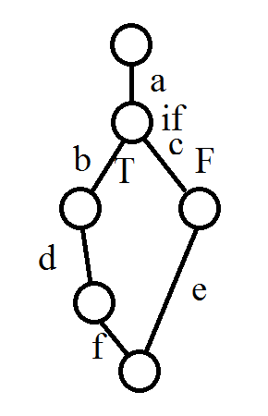
How Many

Slide 27
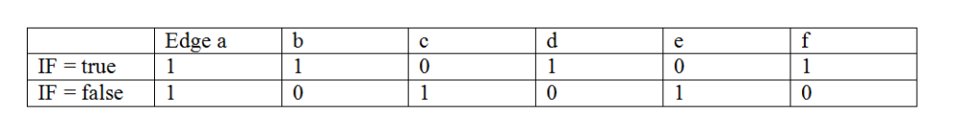
How Many

Slide 28
How Many
The above table shows the two possible paths of the given program graph. One is generated by the true condition of the IF statement. The other is the result of a false IF condition. If you represent the path as a vector of segments, you will end up with two vectors:
(1,1,0,1,0,1) and (1,0,1,0,1,0)
It is quite clear that you can’t represent one vector from another. They are independent.

Slide 29
How Many?
If you have two two-way decisions in your program, your total number possible paths is 4. Nevertheless, the number of independent paths (basis paths) is 3③.

Slide 30
Insights
Again, this line of research does not offer good physical intuition. Nevertheless, mathematically we know (or feel) that the basis paths are special. By testing the basis paths we may avoid testing all possible paths (which is economically not feasible in most cases).

Slide 31
Insights
By now, the readers should have an intuitive way of calculating the number of basis paths for a given program (in literature, it is called Cyclomatic Complexity) is simply, number of 2-way decisions + 1.

Slide 32
Insights
Cyclomatic Complexity = Number of 2-Way Decisions + 1
Or,
Cyclomatic Complexity = e – n + 2p
  Where
  e = number of edges for a given program graph (or called control graph)
  n = number of nodes
  p= number of connected regions (for most cases, usually is 1)

